Slide 1


DEEP2NEURON TECH ACADEMY
INTERNSHIP-2023
CNN FOR IMAGE PROCESSING
DHIVYA R G

Slide 2
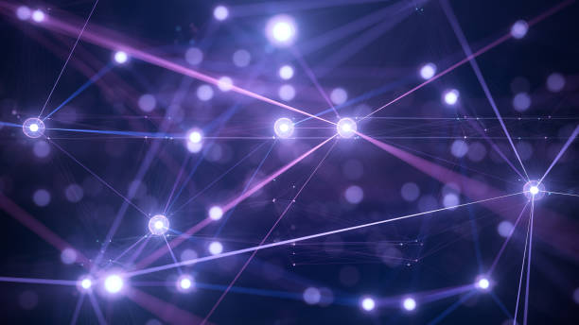
Contents
Deep Learning
Neural Networks
CNN- Introduction
Evolution of CNN architecture
Recognition of images - CNN
Layers of CNN
CNN Working
Applications

Slide 3


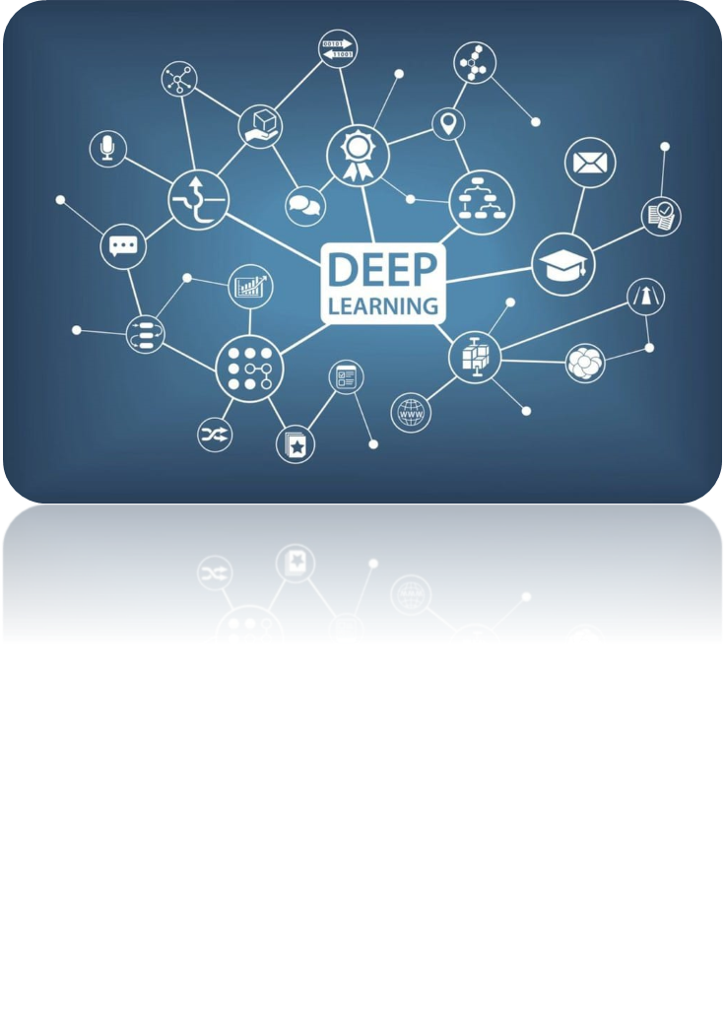
DEEP LEARNING
Type of machine learning and artificial intelligence (AI)
Imitates the way humans gain certain types of knowledge
Includes statistics and predictive modeling

Slide 4
NEURAL NETWORK
Computing systems with interconnected nodes
Series of algorithms
Endeavors to recognize underlying relationships in a set of data
Mimics the way the human brain operates
Refer to systems of neurons, organic or artificial in nature
Can recognize hidden patterns and correlations in raw data, cluster and classify

Slide 5

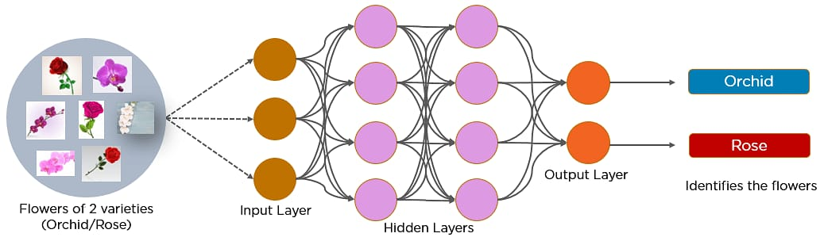
CONVOLUTIONAL NEURAL NETWORKS
A convolutional neural network is a feed-forward neural network that is generally used to analyze visual images by processing data with grid-like topology.
It’s also known as a ConvNet.
Used to detect and classify objects in an image.

Slide 6
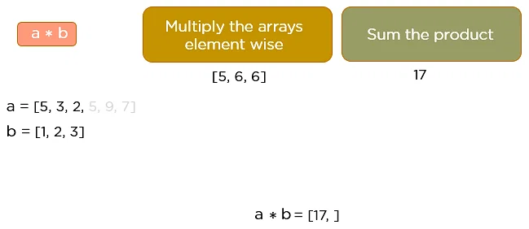
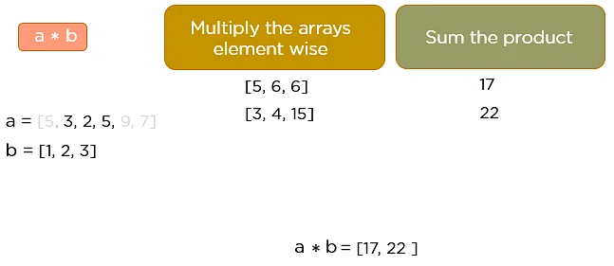

Slide 7
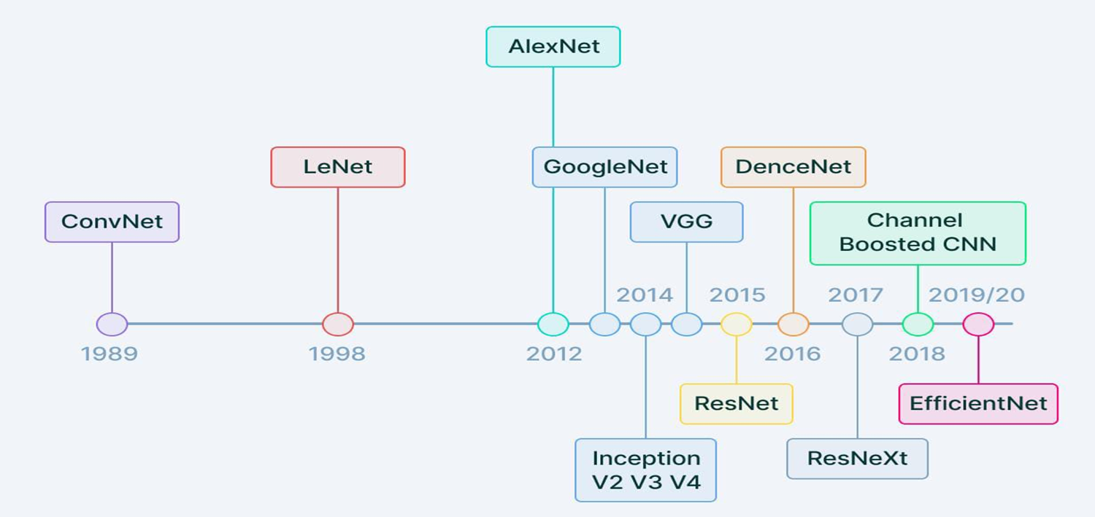
EVOLUTION OF CNN ARCHITECTURE

Slide 8
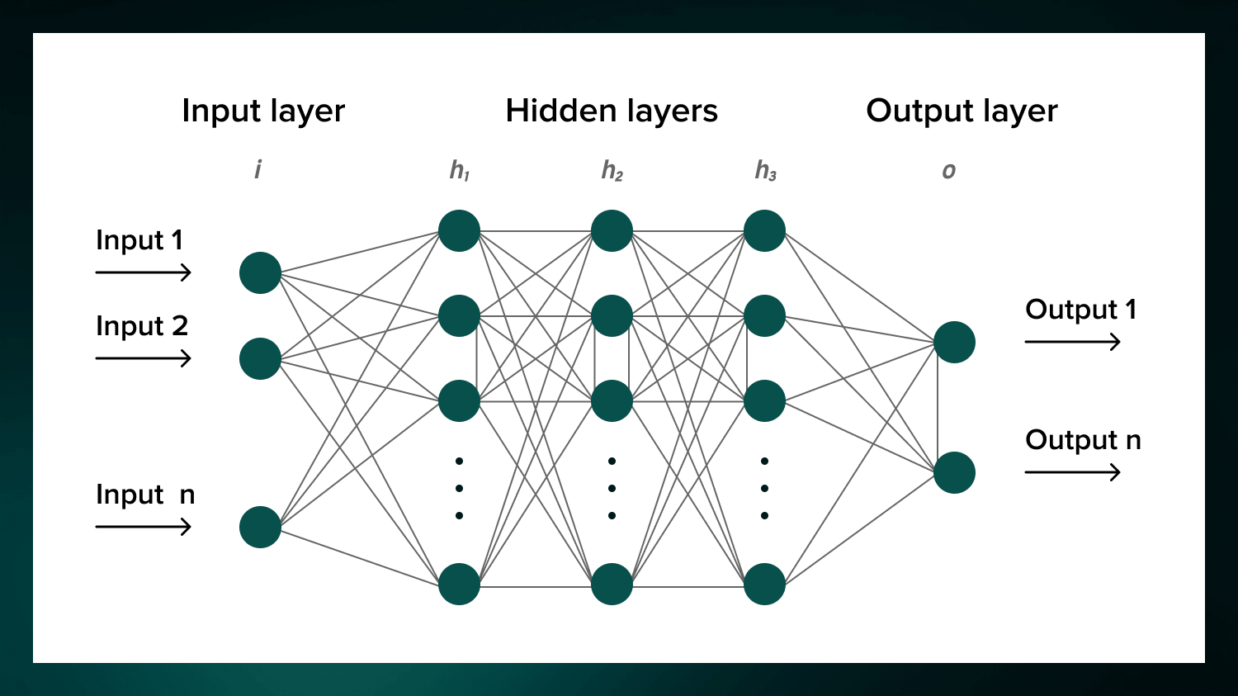
RECOGNITION OF IMAGES - CNN

Slide 9
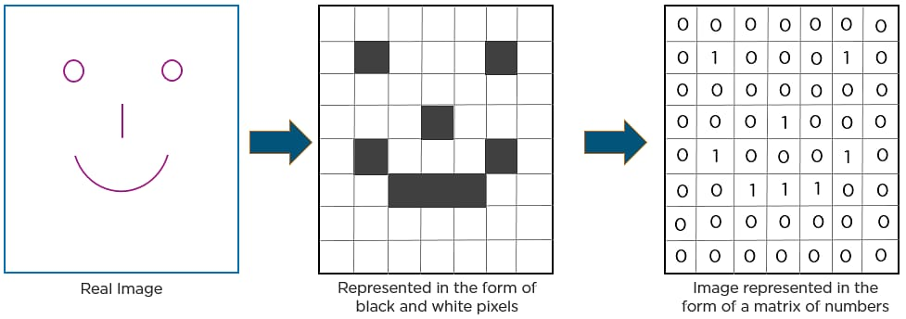
In CNN, every image is represented in the form of an array of pixel
values.

Slide 10

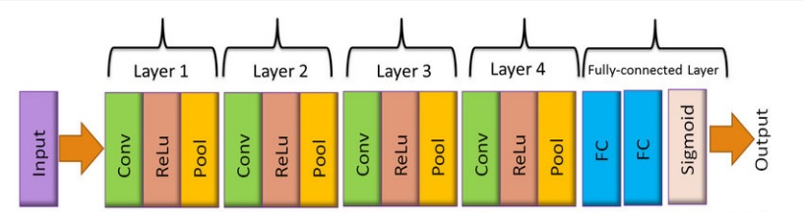
LAYERS OF CNN
Convolutional layer
Relu layer
Pooling layer
Fully Connected layer laye layer

Slide 11

CONVOLUTIONAL LAYER
First step in the process of extracting valuable features from an image.
Contains several filters that perform the convolution operation.
Every image is considered as a matrix of pixel values.

Slide 12
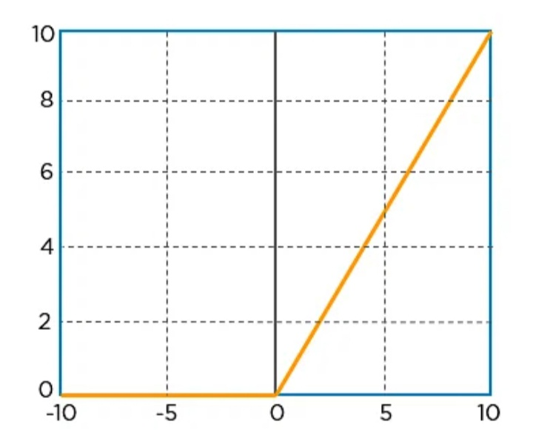
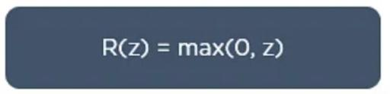
ReLu Layer
Rectified linear unit.
Performs an element-wise operation and sets all the negative pixels to 0.
It introduces non-linearity to the network, generated output is a rectified feature map.

Slide 13
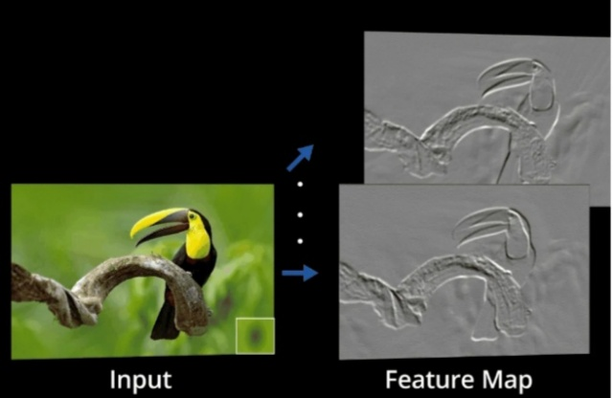
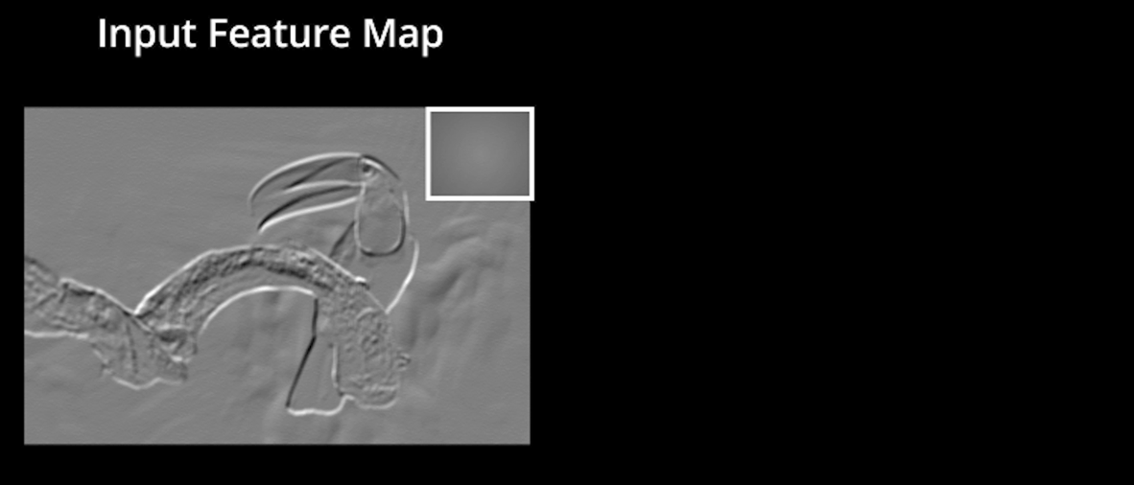

Slide 14
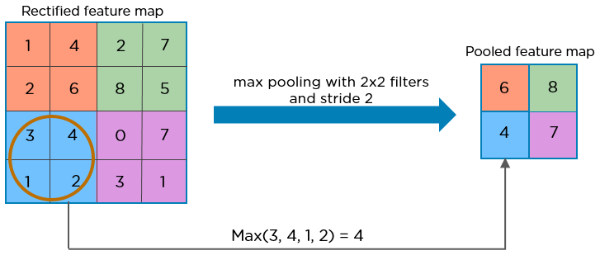
POOLING LAYER
Down-sampling operation that reduces the dimensionality of the feature map.
The rectified feature map goes through a pooling layer to generate a pooled feature map.

Slide 15
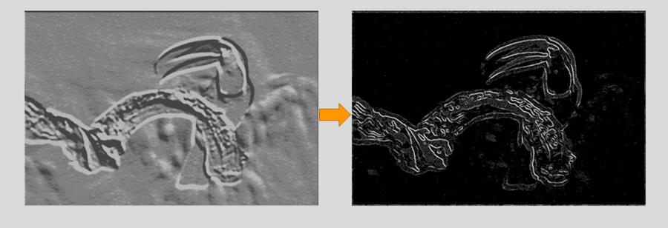
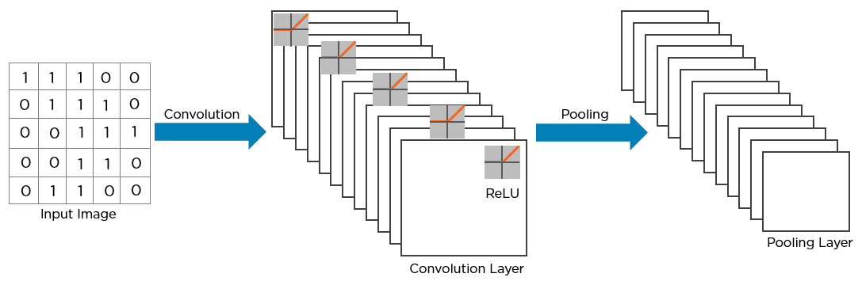

Slide 16
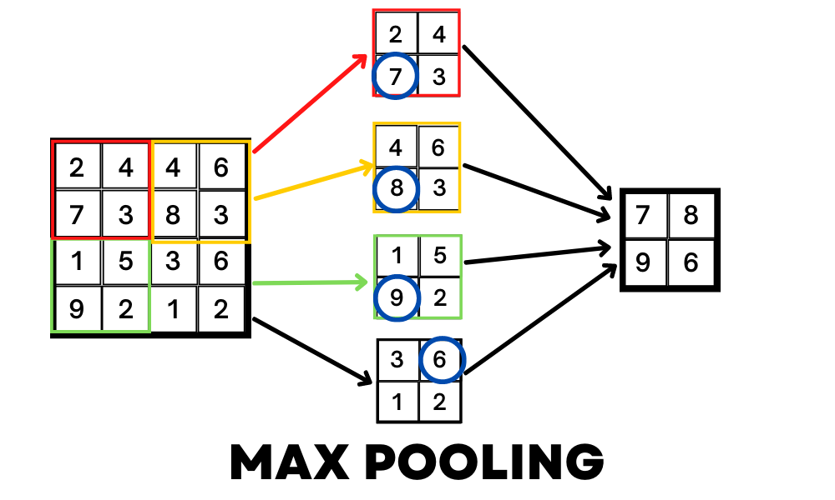

Slide 17
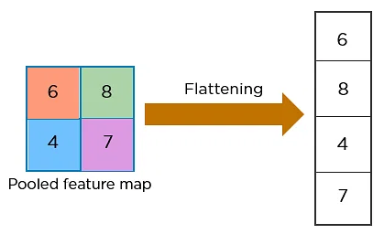
FLATTENING LAYER
Convert the resultant 2-Dimensional arrays from pooled feature maps into a single long continuous linear vector.

Slide 18
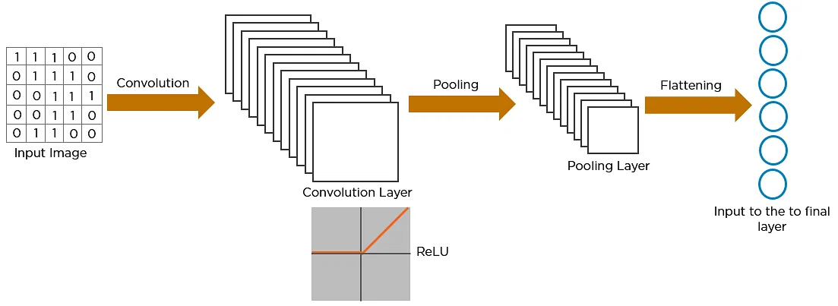

Slide 19
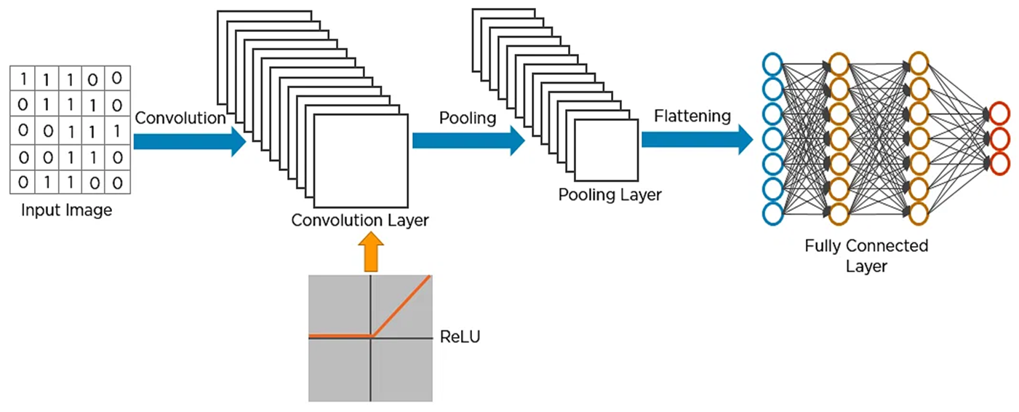
FULLY CONNECTED LAYER
Convolutional Layer + Pooling Layer + input of flattening layer = block in the CNN.
Increased for capturing finer details .

Slide 20
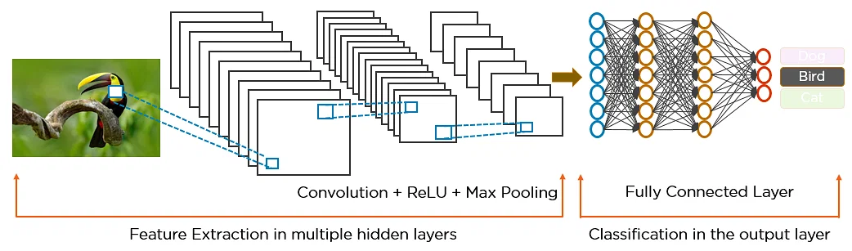
WORKING OF CNN
Local connectivity
Spatial Arrangement
Depth
Stride
Zero Padding
Parameter Sharing

Slide 21
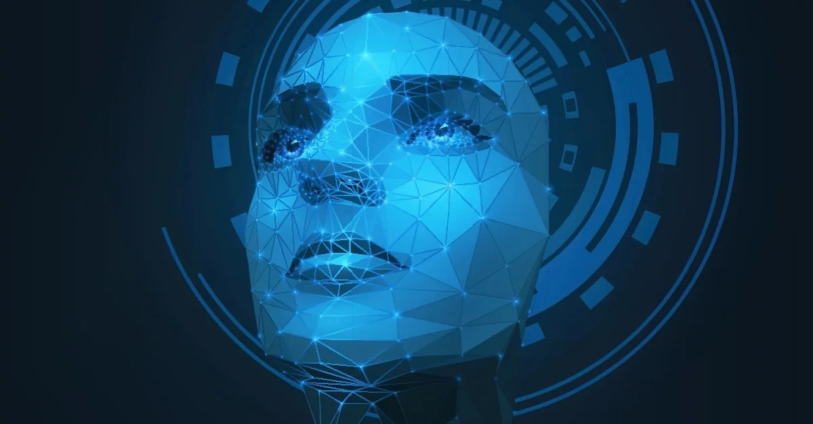

APPLICATIONS
FACIAL RECOGNITION MEDICAL IMAGING

Slide 22
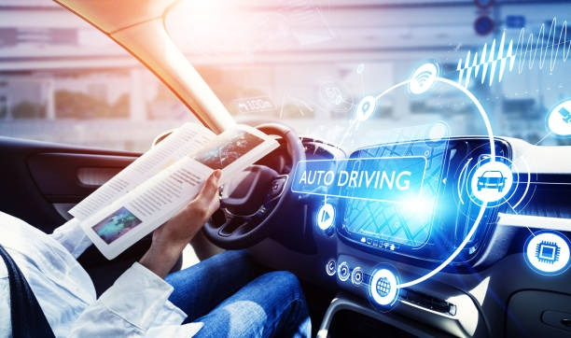

APPLICATIONS
AUTONOMOUS DRIVING BIOMETRIC AUTHENTICATION

Slide 23

THANK YOU

